Slide 1
Introduction to Python
Last extensive revision: Previous revisions:
Jie Gao, Fall 2019 Daniel Moroz, Fall 2015

Slide 2

Plan Day 1
Baby steps
History, Python environments, Docs
Absolute Fundamentals
Objects, Types
Math and Strings basics
References and Mutability
Data Types
Strings, Tuples, Lists, Dictionaries
Looping
Comprehensions
Iterators
Generators
To Be Continued…
CIS 521 | 2
Notes:
.

Slide 3

Python
Developed by Guido van Rossum in the early 90s
Originally Dutch, in USA since 1995.
Benevolent Dictator for Life (now retired)
Available on Eniac; download at python.org
Named after the Monty Python comedy group
CIS 521 | 3
Notes:
Guido van Rossum is the author of Python, an interpreted, interactive object-oriented programming language. In the late 1980s, Van Rossum began work on Python at the National Research Institute for Mathematics and Computer Science in the Netherlands where we worked on the programming language ABC. ABC was intended to be a programming language that could be taught to intelligent computer users who were not computer programmers or software developers in any sense. Instead the focus was on scientists like physicists or social scientists or linguists. Python is partially inspired by his work on the ABC programming language in the 80s. He started developing his own language in 1989. (http://pytalent.zandstrasystems.com/meet_py1.html)
In 1999, Van Rossum submitted a funding proposal to DARPA called "Computer Programming for Everybody", in which he further defined his goals for Python:
* An easy and intuitive language just as powerful as major competitors
* Open source, so anyone can contribute to its development
* Code that is as understandable as plain English
* Suitability for everyday tasks, allowing for short development times
From 2005-2012 Guido worked at Google where he spent half his time developing Python. Now he works at Dropbox.
In 2018, he announced that he would be stepping down from the position of BDFL of the Python programming language
(https://en.wikipedia.org/wiki/Guido_van_Rossum)

Slide 4
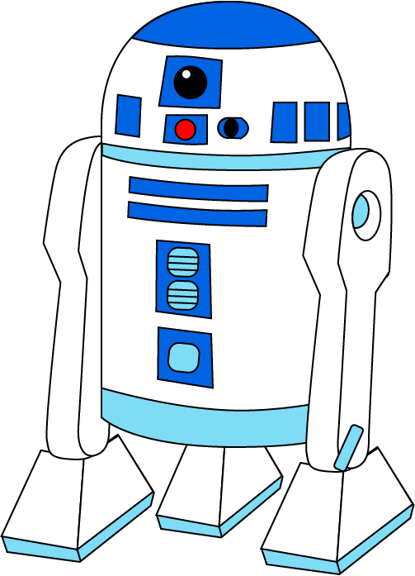


Some Positive Features of Python
Fast development:
Concise, intuitive syntax
Whitespace delimited
Garbage collected
Portable:
Programs run on major platforms without change
cpython: common Python implementation in C.
Various built-in types:
lists, dictionaries, sets: useful for AI
Large collection of support libraries:
NumPy for Matlab like programming
Sklearn for machine learning
Pandas for data analysis
CIS 521 | 4
Notes:
CPython is the reference implementation of the Python programming language. Written in C and Python, CPythonis the default and most widely-used implementation of the language. CPython can be defined as both an interpreter and a compiler as it compiles Python code into bytecode before interpreting it. https://en.wikipedia.org/wiki/CPython

Slide 5
Recommended Reading
Python Overview
The Official Python Tutorial (https://docs.python.org/3/tutorial/index.html)
Slides for CIS192, Spring 2019 (https://www.cis.upenn.edu/~cis192/)
PEPs – Python Enhancement Proposals
PEP 8 - Official Style Guide for Python Code (Guido et al)
Style is about consistency. 4 space indents, < 80 char lines
Naming convention for functions and variables: lower_w_under
Use the automatic pep8 checker!
PEP 20 – The Zen of Python (Tim Peters) (try: import this)
Beautiful is better than ugly; simple is better than complex
There should be one obvious way to do it
That way may not be obvious at first unless you're Dutch
Readability counts
CIS 521 | 5
Notes:
.

Slide 6
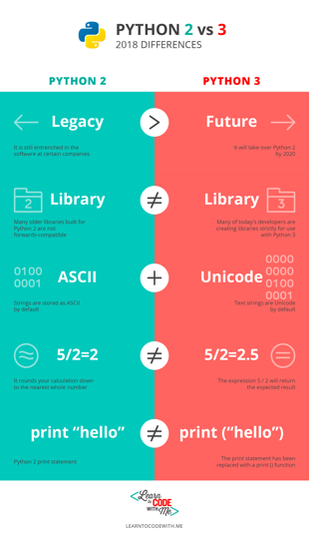
Which Python?
Python 3.7.0 is the latest stable version
Current version on Eniac is 3.6.5, so we’ll use it
Last stable release before version 3.7.4
Why not Python 2?
Latest version 2.7.15.
Python 2.7 will no longer be supported after 2020 (https://pythonclock.org/)
Reading: What should I learn as a beginner: Python 2 or Python 3?
CIS 521 | 6
Notes:
1. PYTHON 2 IS LEGACY, PYTHON 3 IS THE FUTURE.
2. PYTHON 2 AND PYTHON 3 HAVE DIFFERENT (SOMETIMES INCOMPATIBLE) LIBRARIES
3. THERE IS BETTER UNICODE SUPPORT IN PYTHON 3
4. PYTHON 3 HAS IMPROVED INTEGER DIVISION
5. THE TWO VERSIONS HAVE DIFFERENT PRINT STATEMENT SYNTAXES

Slide 7
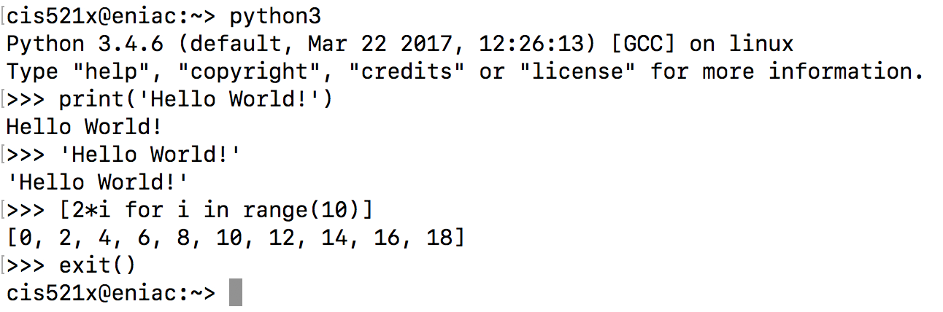
Python REPL Environment
REPL
Read-Evaluate-Print Loop
Type “python” at the terminal
Convenient for testing
If you’d like syntax highlighting in REPL try bpython
You should use Python version 3.7 or version 3.8.
CIS 521 | 7
Notes:
.

Slide 8
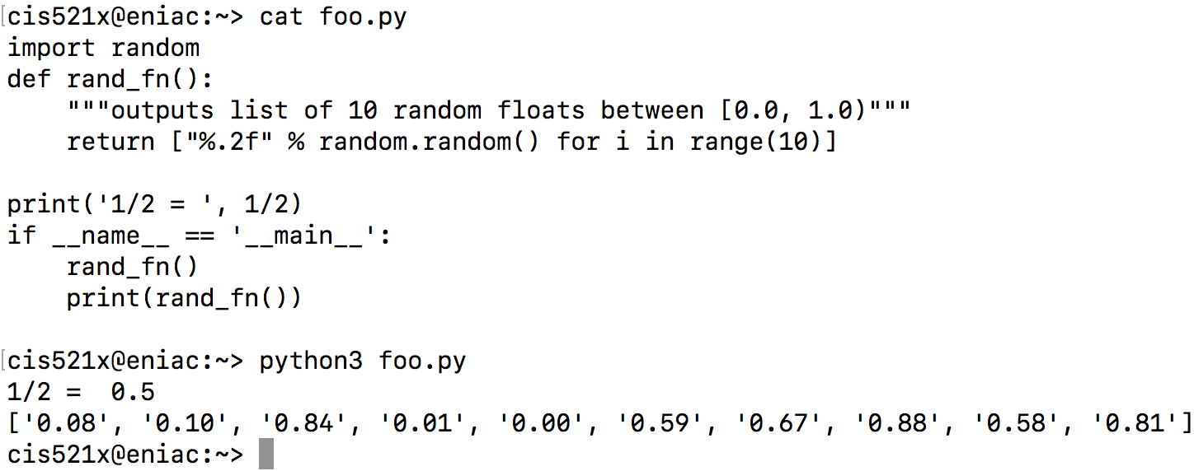
Python Scripts
Scripts
Create a file with your favorite text editor (like Sublime)
Type “python3 script_name.py” at the terminal to run
Not REPL, so you need to explicitly print
Homework submitted as scripts
CIS 521 | 8
Notes:
.

Slide 9
PyCharm IDE
CIS 521 | 9
Notes:
.

Slide 10
Python Notebooks
Jupyter Notebooks allow you to interactively run Python code in your web browser and share it with others in places like Google Colab
They are popular for tutorials since you can include inline text and images
CIS 521 | 10
Notes:
.

Slide 11
Structure of Python File
Whitespace is meaningful in Python
Use a newline to end a line of code.
Use \ when must go to next line prematurely.
Block structure is indicated by indentation
The first line with less indentation is outside of the block.
The first line with more indentation starts a nested block.
Often a colon appears at the end of the line of a start of a new block. (E.g. for function and class definitions.)
CIS 521 | 11
Notes:
.

Slide 12
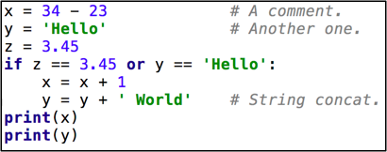
A Simple Code Sample
CIS 521 | 16
Notes:
Syntax highlighting in Pycharm

Slide 13
Objects and Types
All data treated as objects
An object is deleted (by garbage collection) once unreachable.
Strong Typing
Every object has a fixed type, interpreter doesn’t allow things incompatible with that type (eg. “foo” + 2)
type(object)
isinstance(object, type)
Examples of Types:
int, float
str, tuple, dict, list
bool: True, False
None, generator, function
CIS 521 | 12
Notes:
.

Slide 14
Static vs Dynamic Typing
Java: static typing
Variables can only refer to objects of a declared type
Methods use type signatures to enforce contracts
Python: dynamic typing
Variables come into existence when first assigned.
>>> x = "foo”
>>> x = 2
type(var) automatically determined
If assigned again, type(var) is updated
Functions have no type signatures
Drawback: type errors are only caught at runtime
CIS 521 | 13
Notes:
.

Slide 15
Math Basics
Literals
Integers: 1, 2
Floats: 1.0, 2e10
Boolean: True, False
Operations
Arithmetic: + - * /
Power: **
Modulus: %
Comparison: , <=, >=, ==, !=
Logic: (and, or, not) not symbols
Assignment Operators
+= *= /= &= ...
No ++ or --
CIS 521 | 14
Notes:
.

Slide 16
Strings
Creation
Can use either single or double quotes
Triple quote for multiline string and docstring
Concatenating strings
By separating string literals with whitespace
Special use of ‘+’
Prefixing with r means raw.
No need to escape special characters: r’\n’
String formatting
Special use of ‘%’ (as in printf in C)
print("%s can speak %d languages" % ("C3PO", 6000000))
Immutable
CIS 521 | 15
Notes:
String formatting options: https://www.python-course.eu/python3_formatted_output.php

Slide 17
References and Mutability
>>> x = 'foo '
>>> y = x
>>> x = x.strip() # new obj
>>> x
'foo'
>>> y
'foo '
strings are immutable
== checks whether variables point to objects of the same value
is checks whether variables point to the same object
>>> x = [1, 2, 3, 4]
>>> y = x
>>> x.append(5) #same obj
>>> y
[1, 2, 3, 4, 5]
>>> x
[1, 2, 3, 4, 5]
lists are mutable
use y = x[:] to get a (shallow) copy of any sequence, ie. a new object of the same value
CIS 521 | 17
Notes:
.

Slide 18

Sequence types: Tuples, Lists, and Strings
CIS 521 | 18
Notes:
.

Slide 19
Sequence Types
Tuple
A simple immutable ordered sequence of items
Immutable: a tuple cannot be modified once created
Items can be of mixed types, including collection types
Strings
Immutable
Very much like a tuple with different syntax
Regular strings are Unicode and use 2-byte characters (Regular strings in Python 2 use 8-bit characters)
List
Mutable ordered sequence of items of mixed types
CIS 521 | 19
Notes:
.

Slide 20
Sequence Types
The three sequence types share much of the same syntax and functionality.
>>> tu = (23, 'abc', 4.56, (2,3), 'def') # tuple
>>> li = ['abc', 34, 4.34, 23] # list
>>> st = "Hello World"; st = 'Hello World' # strings
>>> tu[1] # Accessing second item in the tuple.
'abc'
>>> tu[-3] #negative lookup from right, from -1
4.56
CIS 521 | 20
Notes:
.

Slide 21
Slicing: Return Copy of a Subsequence
>>> t = (23, 'abc', 4.56, (2,3), 'def')
>>> t[1:4] #slicing ends before last index
('abc', 4.56, (2,3))
>>> t[1:-1] #using negative index
('abc', 4.56, (2,3))
>>> t[1:-1:2] # selection of every nth item.
('abc', (2,3))
>>> t[:2] # copy from beginning of sequence
(23, 'abc')
>>> t[2:] # copy to the very end of the sequence
(4.56, (2,3), 'def')
CIS 521 | 21
Notes:
.

Slide 22
Operations on Lists
>>> li = [1, 11, 3, 4, 5]
>>> li.append('a') # Note the method syntax
>>> li
[1, 11, 3, 4, 5, 'a']
>>> li.insert(2, 'i')
>>> li
[1, 11, 'i', 3, 4, 5, 'a']
>>> li = ['a', 'b', 'c', 'b']
>>> li.index('b') # index of first occurrence
1
>>> li.count('b') # number of occurrences
2
>>> li.remove('b') # remove first occurrence
>>> li
['a', 'c', 'b']
CIS 521 | 22
Notes:
.

Slide 23
Operations on Lists 2
>>> li = [5, 2, 6, 8]
>>> li.reverse() # reverse the list *in place* (modify)
>>> li
[8, 6, 2, 5]
>>> li.sort() # sort the list *in place*
>>> li
[2, 5, 6, 8]
>>> li.sort(some_function)
# sort in place using user-defined comparison
>>> sorted(li) #return a *copy* sorted
CIS 521 | 23
Notes:
.

Slide 24
Operations on Strings
>>> s = "Pretend this sentence makes sense."
>>> words = s.split(" ")
>>> words
['Pretend', 'this', 'sentence', 'makes', 'sense.']
>>> "_".join(words) #join method of obj "_"
'Pretend_this_sentence_makes_sense.'
>>> s = 'dog'
>>> s.capitalize()
'Dog'
>>> s.upper()
'DOG’
>>> ' hi --'.strip(' –')
'hi’
https://docs.python.org/3.7/library/string.html
CIS 521 | 24
Notes:
.

Slide 25
Tuples
>>> a = ["apple", "orange", "banana"]
>>> for (index, fruit) in enumerate(a):
... print(str(index) + ": " + fruit)
...
0: apple
1: orange
2: banana
>>> a = [1, 2, 3]
>>> b = ['a', 'b', 'c', 'd']
>>> list(zip(a, b))
[(1, 'a'), (2, 'b'), (3, 'c')]
>>> list(zip("foo", "bar"))
[('f', 'b'), ('o', 'a'), ('o', 'r')]
>>> x, y, z = 'a', 'b', 'c'
CIS 521 | 25
Notes:
.

Slide 26

Dictionaries: a mapping collection type
CIS 521 | 26
Notes:
.

Slide 27
Dict: Create, Access, Update
Dictionaries are unordered & work by hashing, so keys must be immutable
Constant average time add, lookup, update
>>> d = {'user' : 'bozo', 'pswd': 1234}
>>> d['user']
'bozo'
>>> d['bozo']
Traceback (most recent call last):
File "<stdin>", line 1, in <module>
KeyError: 'bozo'
>>> d['user'] = 'clown' # Assigning to an existing key replaces its value.
>>> d
{'user': 'clown', 'pswd': 1234}
CIS 521 | 27
Notes:
.

Slide 28
Dict: Useful Methods
>>> d = {'user':'bozo', 'p':1234, 'i':34}
>>> d.keys() # List of current keys
dict_keys(['user', 'p', 'i'])
>>> d.values() # List of current values.
dict_values(['bozo', 1234, 34])
>>> d.items() # List of item tuples.
dict_items([('user', 'bozo'), ('p', 1234), ('i', 34)])
>>> from collections import defaultdict
>>> d = defaultdict(int)
>>> d['a']
0
defaultdict automatically initializes nonexistent dictionary values
CIS 521 | 28
Notes:
.

Slide 29

For Loops
CIS 521 | 29
Notes:
.

Slide 30

For Loops
for <item> in <collection>: <statements>
If you’ve got an existing list, this iterates each item in it.
You can generate a list with Range:
list(range(5)) returns [0,1,2,3,4]
So we can say: for x in range(5): print(x)
<item> can be more complex than a single variable name.
for (x, y) in [('a',1), ('b',2), ('c',3), ('d',4)]:
print(x)
CIS 521 | 30
Notes:
.

Slide 31
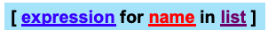
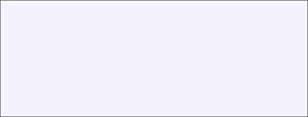
List Comprehensions replace loops!
nums = [0, 1, 2, 3, 4, 5, 6, 7, 8, 9]
# I want 'n*n' for each 'n’ in nums
squares = []
for n in nums:
for n in nums:
squares.append(x*x)
print(squares)
squares = [x*x for x in nums]
print(squares)
CIS 521 | 31

Slide 32
List Comprehensions replace loops!
>>> li = [3, 6, 2, 7]
>>> [elem * 2 for elem in li]
[6, 12, 4, 14]
>>> li = [('a', 1), ('b', 2), ('c', 7)]
>>> [n * 3 for (x, n) in li]
[3, 6, 21]
CIS 521 | 32
Notes:
CCB – todo – show how the list comprehension can be re-written as a for loop.

Slide 33
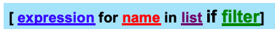
Filtered List Comprehensions
>>> li = [3, 6, 2, 7, 1, 9]
>>> [elem * 2 for elem in li if elem > 4]
[12, 14, 18]
Only 6, 7, and 9 satisfy the filter condition.
So, only 12, 14, and 18 are produced.
CIS 521 | 33
Notes:
.

Slide 34
List Comprehension extra for
lst1, lst2, lst3 = [1, 2, 3], [2, 3, 4], [3, 4, 5]
res = [(x, y, z) for x in lst1 if x < 2 \
for y in lst2 \
for z in lst3 if x + y + z < 8]
res = [] # translation
for x in lst1:
if x < 2:
for y in lst2:
for z in lst3:
if x + y + z < 8:
res.append((x, y, z))
# Both value of res: [(1, 2, 3), (1, 2, 4), (1, 3, 3)]
CIS 521 | 34
Notes:
.

Slide 35
Dictionary, Set Comprehensions
lst1 = [('a', 1), ('b', 2), ('c', 'hi')]
lst2 = ['x', 'a', 6]
d = {k: v for k,v in lst1}
s = {x for x in lst2}
d = dict() # translation
for k, v in lst1:
d[k] = v
s = set() # translation
for x in lst:
s.add(x)
# Both value of d: {'a': 1, 'b': 2, 'c': 'hi’}
# Both value of d: {'x', 'a', 6}
CIS 521 | 35
Notes:
.

Slide 36

Iterators
CIS 521 | 36
Notes:
.

Slide 37
Iterator Objects
Iterable objects can be used in a for loop because they have an __iter__ magic method, which converts them to iterator objects:
>>> k = [1,2,3]
>>> k.__iter__()
<list_iterator object at 0x104f8ca50>
>>> iter(k)
<list_iterator object at 0x104f8ca10>
CIS 521 | 37
Notes:
.

Slide 38
Iterators
Iterators are objects with a __next__() method:
>>> i = iter(k)
>>> next(i)
1
>>> i.__next__()
2
>>> i.next()
3
>>> i.next()
Traceback (most recent call last):
File "<stdin>", line 1, in <module>
StopIteration
Python iterators do not have a hasnext() method!
Just catch the StopIteration exception
CIS 521 | 38
Notes:
.

Slide 39
Iterators: The truth about for… in…
for <item> in <iterable>: <statements>
First line is just syntactic sugar for:
1. Initialize: Call <iterable>.__iter__() to create an iterator
Each iteration:
2. Call iterator.__next__() and bind <item>
2a. Catch StopIteration exceptions
To be iterable: has __iter__ method
which returns an iterator obj
To be iterator: has __next__ method
which throws StopIteration when done
CIS 521 | 39
Notes:
.

Slide 40

An Iterator Class
class Reverse:
"Iterator for looping over a sequence backwards"
def __init__(self, data):
self.data = data
self.index = len(data)
def __next__(self):
if self.index == 0:
raise StopIteration
self.index = self.index - 1
return self.data[self.index]
def __iter__(self):
return self
>>> for char in Reverse('spam'):
print(char)
CIS 521 | 40
Notes:
.

Slide 41
Iterators use memory efficiently
Eg: File Objects
>>> for line in open(“script.py”): # returns iterator
... print(line.upper())
...
IMPORT SYS
PRINT(SYS.PATH)
X = 2
PRINT(2 ** 3)
instead of
>>> for line in open(“script.py”).readlines(): #returns list
... print(line.upper())
...
CIS 521 | 41
Notes:
.

Slide 42

Generators
CIS 521 | 42
Notes:
.

Slide 43
Generators: using yield
Generators are iterators (with __next()__ method)
Creating Generators: yield
Functions that contain the yield keyword automatically return a generator when called
>>> def f(n):
... yield n
... yield n+1
...
>>>
>>> type(f)
<class 'function'>
>>> type(f(5))
<class 'generator'>
>>> [i for i in f(6)]
[6, 7]
CIS 521 | 43
Notes:
.

Slide 44
Generators: What does yield do?
Each time we call the __next__ method of the generator, the method runs until it encounters a yield statement, and then it stops and returns the value that was yielded. Next time, it resumes where it left off.
>>> gen = f(5) # no need to say f(5).__iter__()
>>> gen
<generator object f at 0x1008cc9b0>
>>> gen.__next__()
5
>>> next(gen)
6
>>> gen.__next__()
Traceback (most recent call last):
File "<stdin>", line 1, in <module>
StopIteration
CIS 521 | 44
Notes:
.

Slide 45
Generators
xrange(n) vs range(n) in Python 2
xrange acts like a generator
range(n) keeps all n values in memory before starting a loop even if n is huge: for k in range(n)
sum(xrange(n)) much faster than sum(range(n)) for large n
In Python 3
xrange(n) is removed
range(n) acts similar to the old xrange(n)
Can use list() to get similar behavior as in Python 2
Python 3’s range is more powerful than Python 2’s xrange
CIS 521 | 45
Notes:
.

Slide 46
Generators
Benefits of using generators
Less code than writing a standard iterator
Maintains local state automatically
Values are computed one at a time, as they’re needed
Avoids storing the entire sequence in memory
Good for aggregating (summing, counting) items. One pass.
Crucial for infinite sequences
Bad if you need to inspect the individual values
CIS 521 | 46
Notes:
.

Slide 47
Using generators: merging sequences
Problem: merge two sorted lists, using the output as a stream (i.e. not storing it).
def merge(l, r):
llen, rlen, i, j = len(l), len(r), 0, 0
while i < llen or j < rlen:
if j == rlen or (i < llen and l[i] < r[j]):
yield l[i]
i += 1
else:
yield r[j]
j += 1
CIS 521 | 47
Notes:
.

Slide 48
Using generators
>>> g = merge([2,4], [1, 3, 5]) #g is an iterator
>>> while True:
... print(g.__next__())
...
1
2
3
4
5
Traceback (most recent call last):
File "<stdin>", line 2, in <module>
StopIteration
>>> [x for x in merge([1,3,5],[2,4])]
[1, 2, 3, 4, 5]
CIS 521 | 48
Notes:
.

Slide 49
Generators and exceptions
>>> g = merge([2,4], [1, 3, 5])
>>> while True:
... try:
... print(g.__next__())
... except StopIteration:
... print('Done’)
... break
...
1
2
3
4
5
Done
CIS 521 | 49
Notes:
.

Slide 50
Generator comprehensions
Review: generators are good for aggregating items.
For example, in Python 2, sum(xrange(n)) was much faster than sum(range(n)) for large n
Similarly,
>>> sum(x for x in xrange(10**8) if x%5==0)
999999950000000L
which uses a generator comprehension is much faster than
>>> sum([x for x in xrange(10**8) if x%5==0])
999999950000000L
which creates the entire list before computing the sum
CIS 521 | 50
Notes:
.

Slide 51
Plan for next time
Import
Functions
Args, kwargs
Classes
“magic” methods (objects behave like built-in types)
Profiling
timeit
cProfile
CIS 521 | 51
Notes:
.

